Slide 1

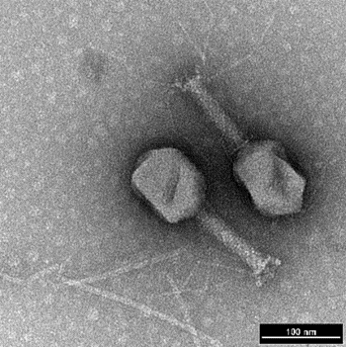

Bacteriophage Genomic Assembly, Annotation and Taxonomy Workshop March 18th – 20th 2025 DAY 2 Bacteriophage Research Lab Guelph RDC
Notes:
1

Slide 2
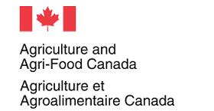

Agriculture & Agri-Food Canada Phage Genomics Workshop
Andrew M. Kropinski
Department of Pathobiology
University of Guelph, Canada
Email: Phage.Canada@gmail.com
Notes:
http://tbilisee.com/en/places/in/49-Education

Slide 3
PART 2
Genome annotation
APOLOGY: NO AUTOANNOTATION SOFTWARE
PACKAGE IS PERFECT. YOU WILL NEED TO DO A LOT
OF PROOFREADING TO ACHIEVE A HIGH-QUALITY
ANNOTATED VIRAL GENOME

Slide 4



Outline
Online primary genome annotation with DFAST, PHAROKKA or RAST – PART 2A
Massaging *.gbk file
Identification of missing coding sequences using UGENE or Geneious Prime – PART 2B
GenBank file types & their interconversion – PART 2C
Examination of proteins for conserved motifs
– PART 2D
Updated GenBank flatfile (*.gbk)

Slide 5
Annotation outcome
We want to identify the location and function of all the genes on our phage genome:
Two main classes encode proteins and tRNAs
Notes:
https://bmcmicrobiol.biomedcentral.com/articles/10.1186/1471-2180-11-213

Slide 6
Automated Annotation – PART 2A
Proksee - https://proksee.ca/ uses Prokka
RAST - Rapid Annotation using Subsystem Technology (https://rast.nmpdr.org/)
DFAST - DDBJ Fast Annotation and Submission Tool. (https://dfast.nig.ac.jp/)
BV-BRC - Bacterial and Viral Bioinformatics Resource Center (https://www.bv-brc.org/app/Annotation)
GenSAS v6.0 - https://www.gensas.org/
MicroScope Microbial Genome Annotation & Analysis Platform - https://mage.genoscope.cns.fr/microscope/home/index.php
Bakta Web - https://bakta.computational.bio/
All except DFAST & Bakta require free online registration

Slide 7
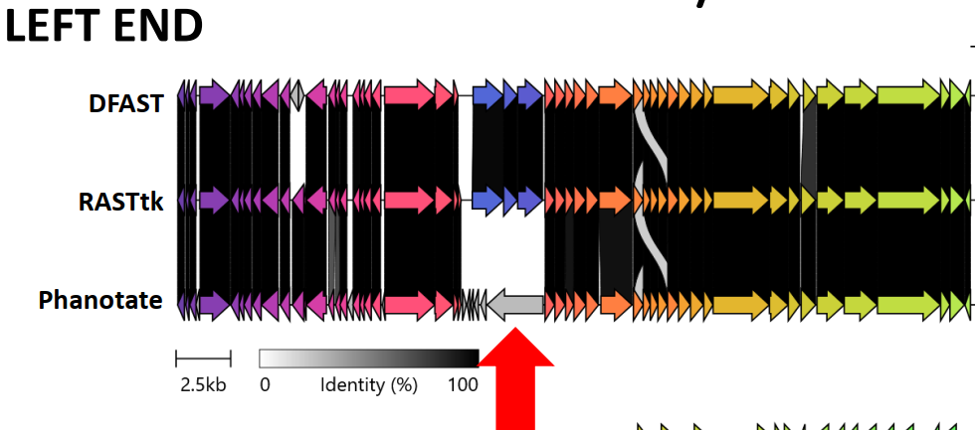
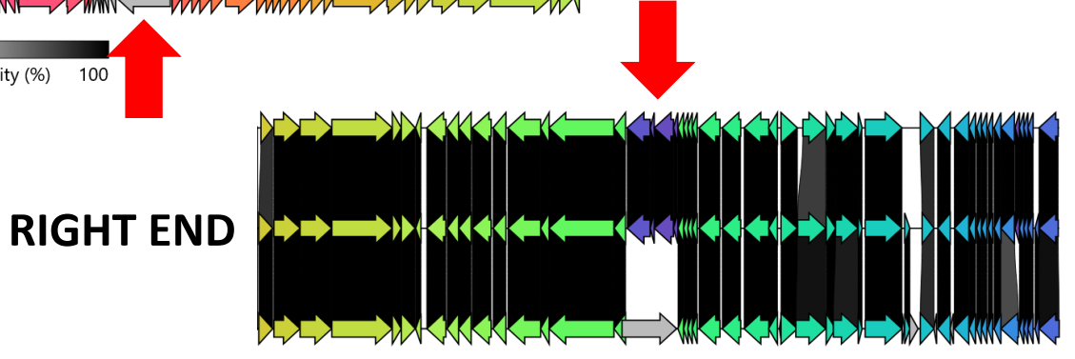
Use Pharokka with caution at Galaxy.eu

Slide 8
First pass annotation using DFAST
DDBJ Fast Annotation and Submission Tool
associated with DNA Data Bank of Japan
Tanizawa Y et al. 2018. Bioinformatics. 34(6): 1037-1039. doi: 10.1093/bioinformatics/ btx713. PMID: 29106469
https://dfast.ddbj.nig.ac.jp/
click on “Start your project”

Slide 9
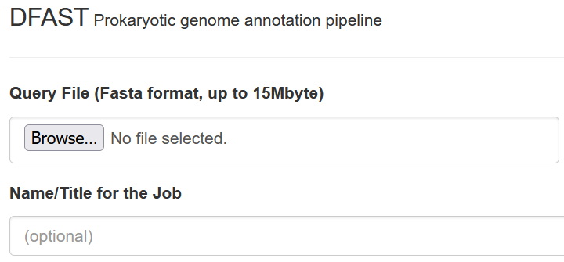
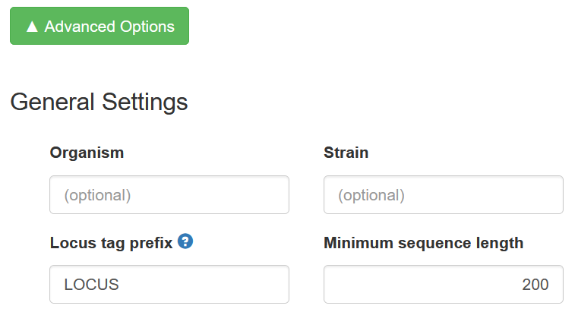

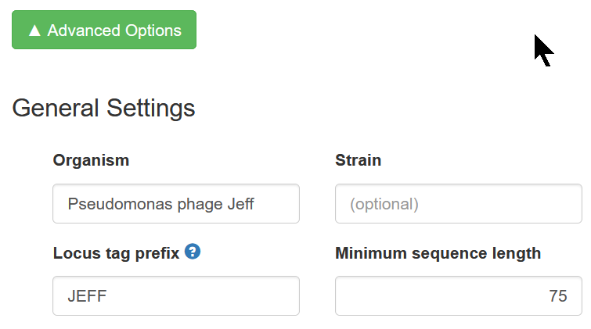

Input
Name of your phage - JEFF
Institute + # - GRDC57

Slide 10
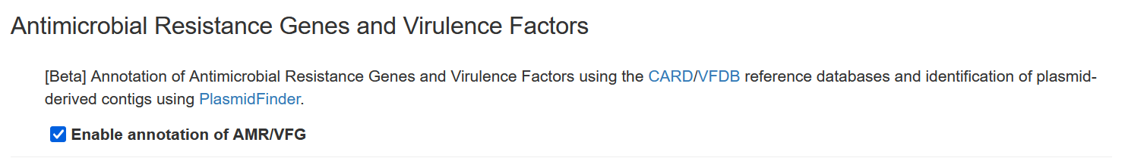
AMR/Virulence Factors

Slide 11
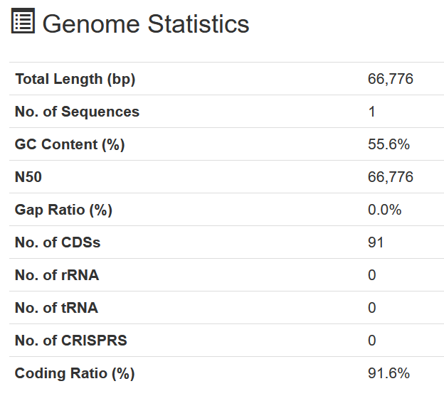
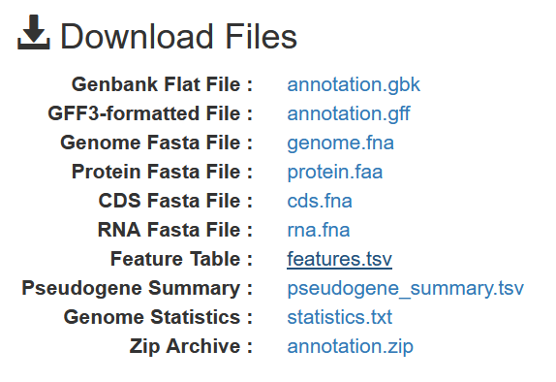
Results
17 seconds latter:

Slide 12
What do they all mean?
*.faa Protein FASTA file of the translated CDS sequences.
*.ffn Nucleotide FASTA file of all the prediction transcripts (CDS, rRNA, tRNA, tmRNA, misc_RNA)
*.fna Nucleotide FASTA file.
*.gbk This is a standard GenBank flatfile
*.gff This is the master annotation in GFF3 format, containing both sequences and annotations.
*.tsv Tab-separated file of all features

Slide 13
Problems with DFAST
it is prokaryote annotation pipeline NOT a phage pipeline, therefore annotations are incomplete and skewed.
while you can change the translation code from 11 (default) to 4 you cannot change it to 15 which is used by some gut phages.
splicing not recognized:
in GenBank record this is reported as CDS join(99941..100807,101606..103957)
important with members of the Herelleviridae, such as Staphylococcus phages; and, Campylobacter phages
Notes:
https://pmc.ncbi.nlm.nih.gov/articles/PMC9197471/

Slide 14
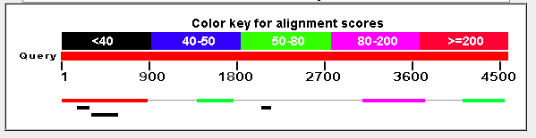
Introns and Inteins – rare but
the gene encoding the aerobic ribonucleoside diphosphate reductase (large subunit) from Campylobacter phage vB_CcoM-IBB_35 is located on a 4.5 kb region which homologous to a 2.3 kb region from Klebsiella phage vB_KleM-RaK2. N.B. proteins have similar mass.
N.B. the thin grey line joining blocks indicates a downstream sequence which is similar
Notes:
Bottom line – look out for the unexpected particularly in the case of Staphylococcus and Campylobacter phages

Slide 15
Editing primary annotation (*.gbk) files
No matter what program you use you will have to edit the results
Notepad++ is better than Notepad
Install from: https://notepad-plus-plus.org/
Notes: https://www.youtube.com/watch?v=wVfbFe57h2o

Slide 16
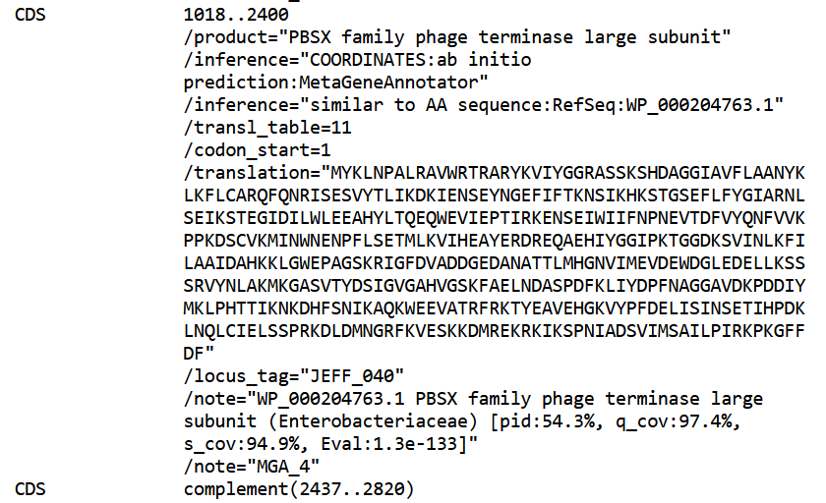


Open in Notepad++
Install from: https://notepad-plus-plus.org/
Comment
Delete
Comment

Slide 17
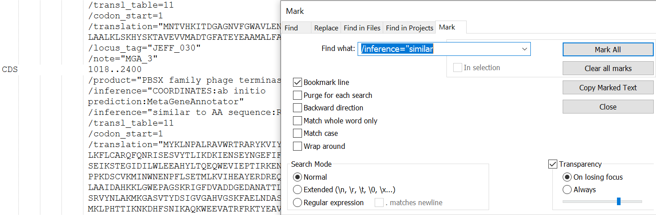
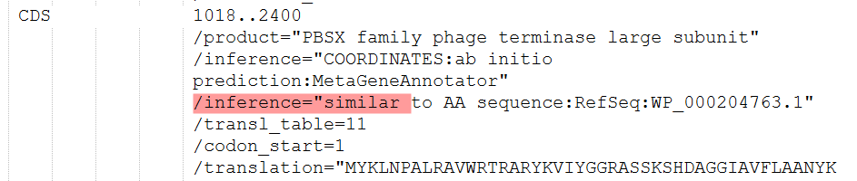
Open in Notepad++
Under: “Search” choose “Mark” and “Mark All”

Slide 18
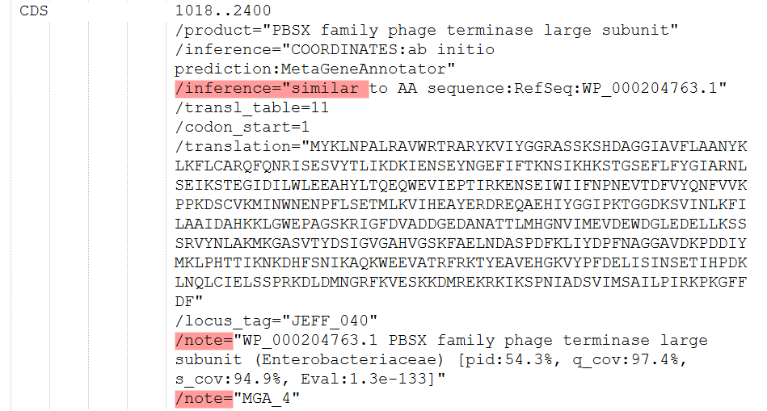
Mark All/Delete
Under “Search”, choose “Bookmark” and “Remove Bookmarked Lines”
It will not remove multiple lines so you will have to manually accomplish this
shorten “product” to: terminase, large subunit

Slide 19
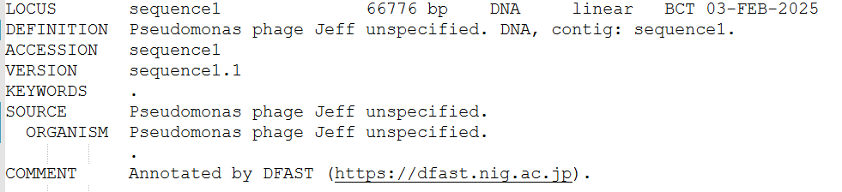
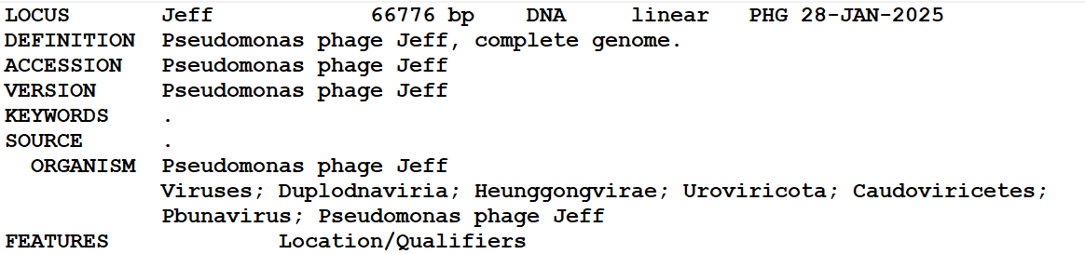
Edit top of *.gbk file
This will be discussed in this workshop BUT in many cases the taxonomy can be readily assessed from the BLASTN hits

Slide 20

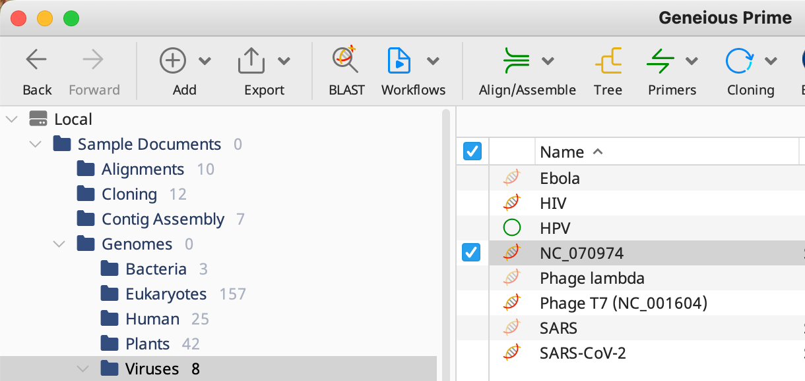
Visualizing & editing GBK files using Geneious Prime – PART 2B
Import desired gbk file into Viruses Database

Slide 21
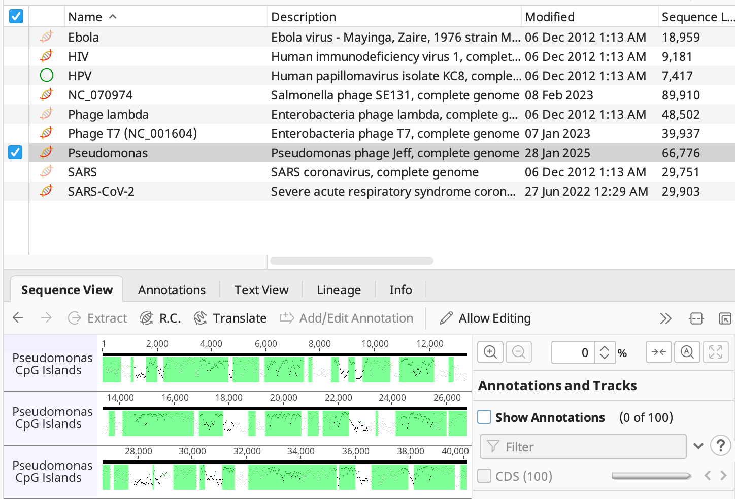
View

Slide 22
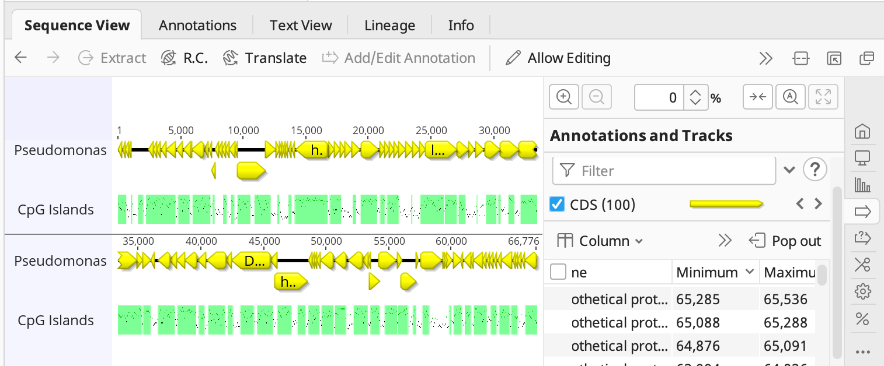

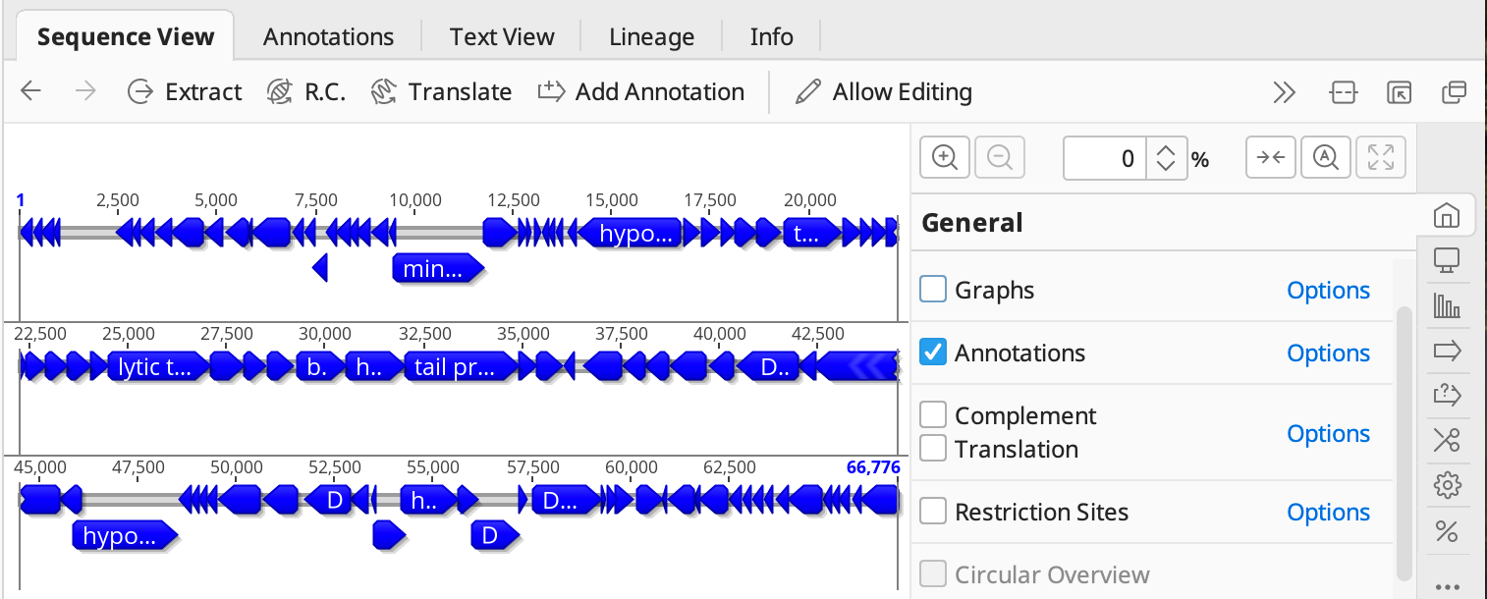
See annotations

Slide 23
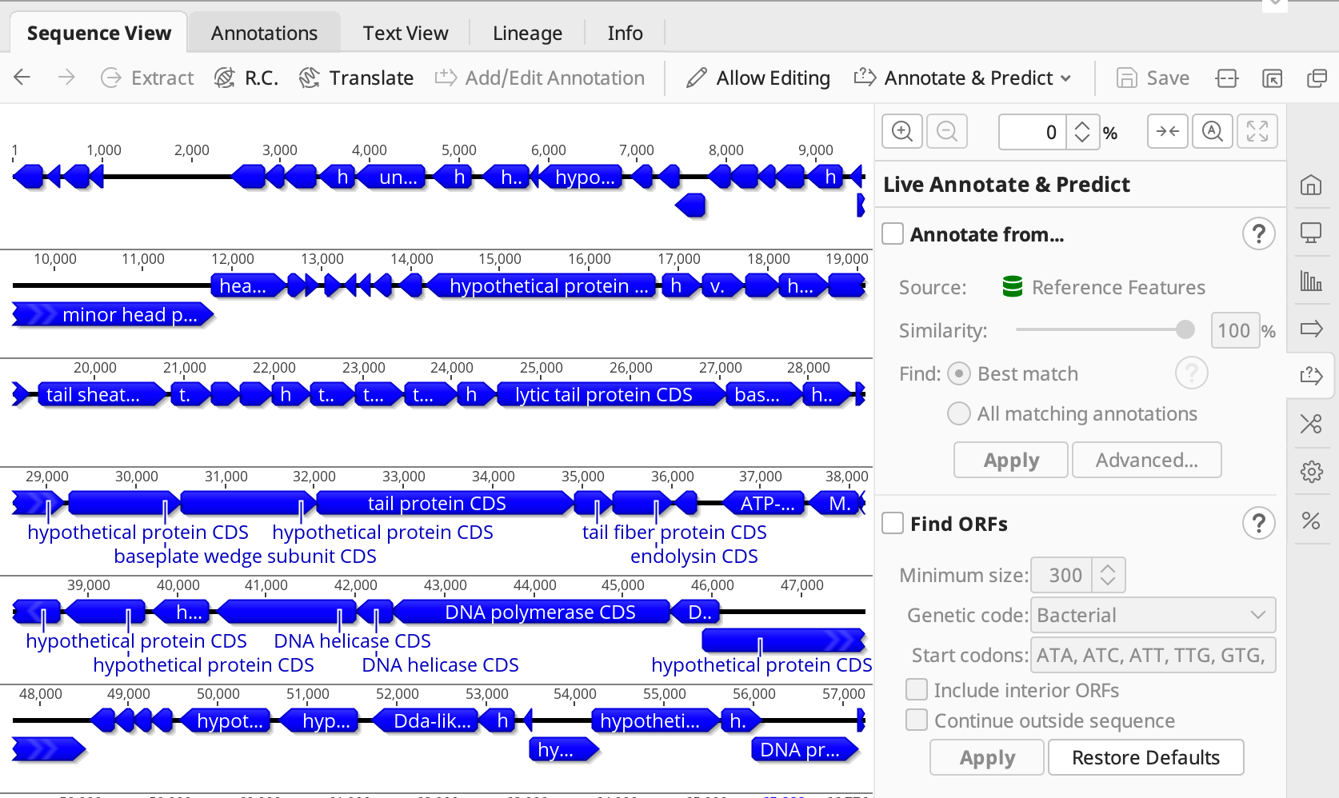


Find missing ORFs
Minimum size: 228 nt = 75 amino acids plus stop codon

Slide 24
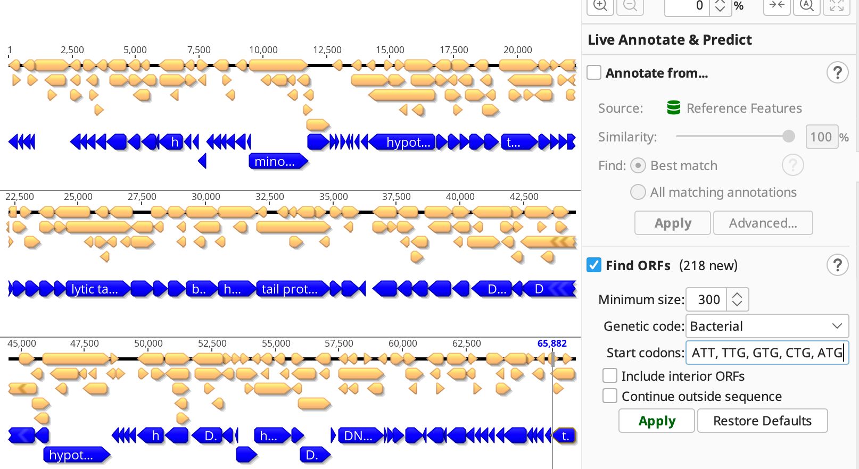
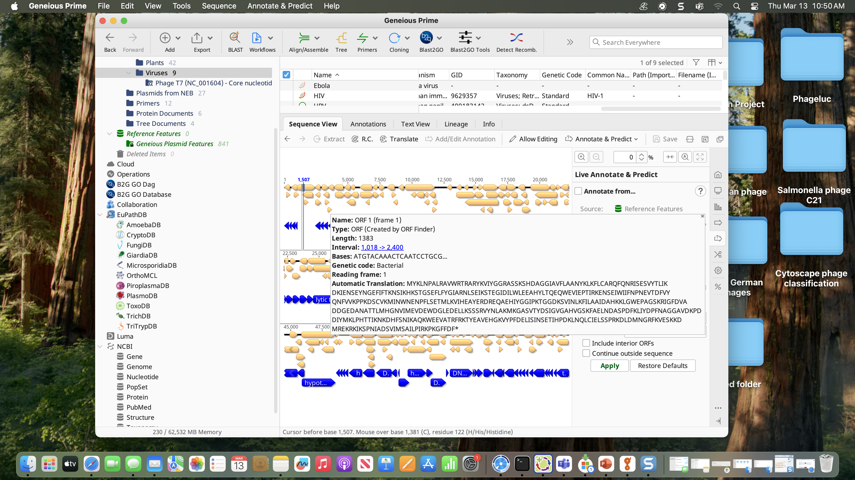
Find missing ORFs 2
BLASTp vs Caudoviricetes (taxid:2731619)
Add new feature to the annotation

Slide 25
OR

Slide 26

Visualizing & editing GBK files using UGENE – PART 2B
Rose R et al. 2019. Bioinformatics 35(11): 1963- 1965 doi: 10.1093/bioinformatics/bty901. PMID: 30358807.
Window, Linux & Mac versions
http://ugene.net/
podcasts:
https://www.youtube.com/ @UniproUGENE

Slide 27
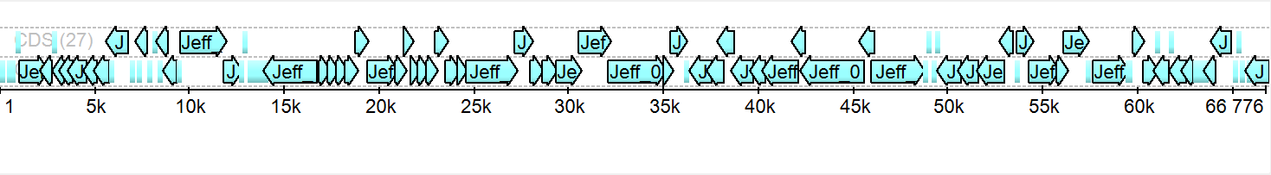
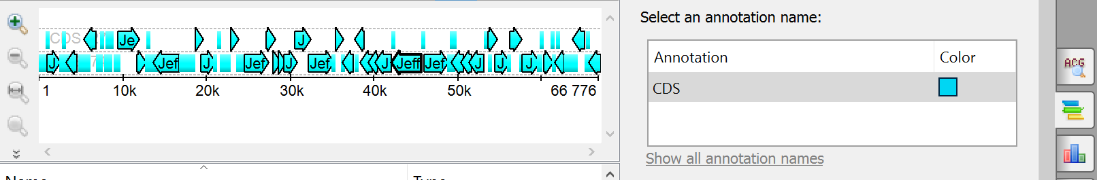
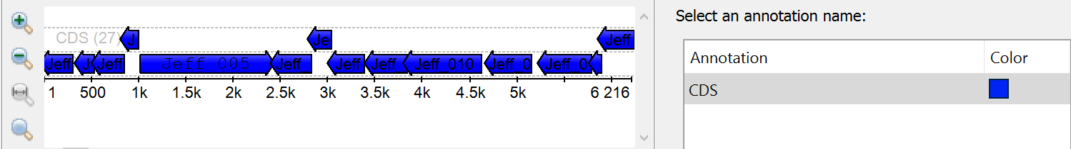
UGENE
Click here to change colour
Magnification

Slide 28
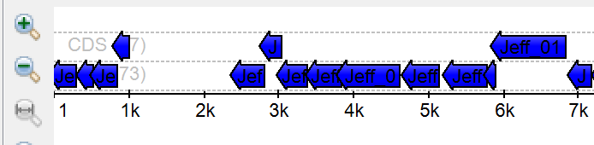
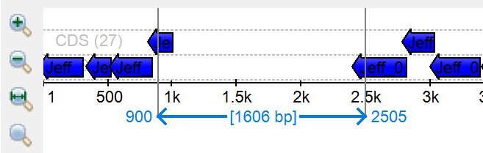
Screen for missing genes
appear as gaps
Highlight “missing region”

Slide 29
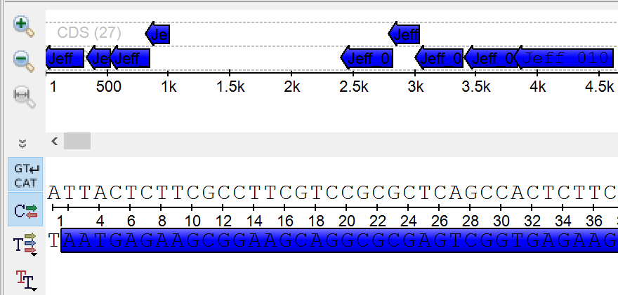
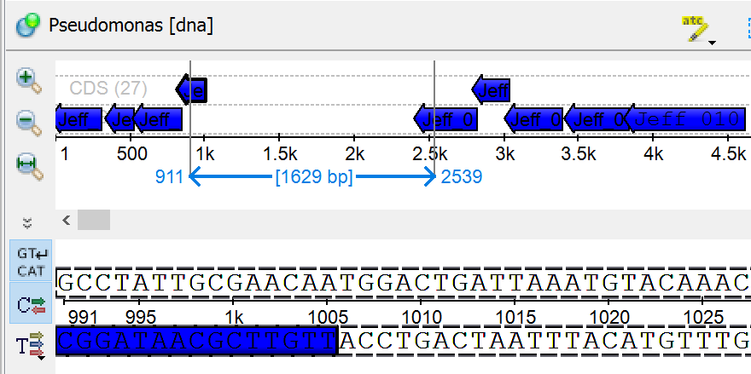
See sequence data

Slide 30


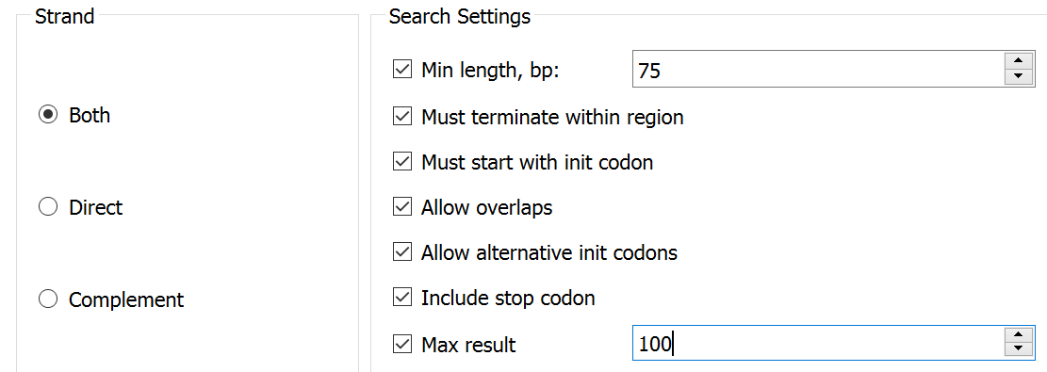


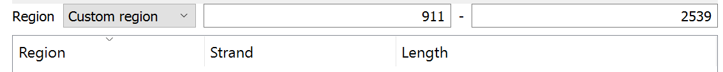
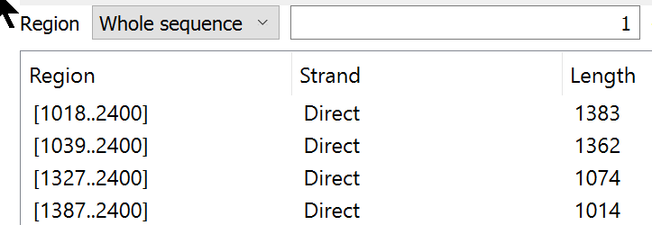
Find ORF
Click
here

Slide 31
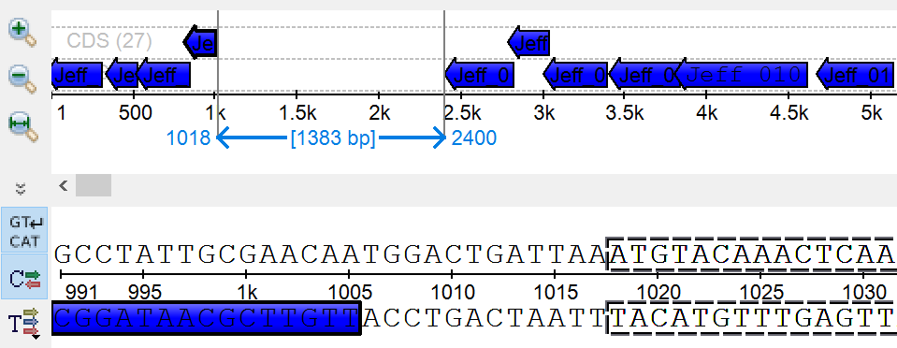
Find ORF 2

Slide 32
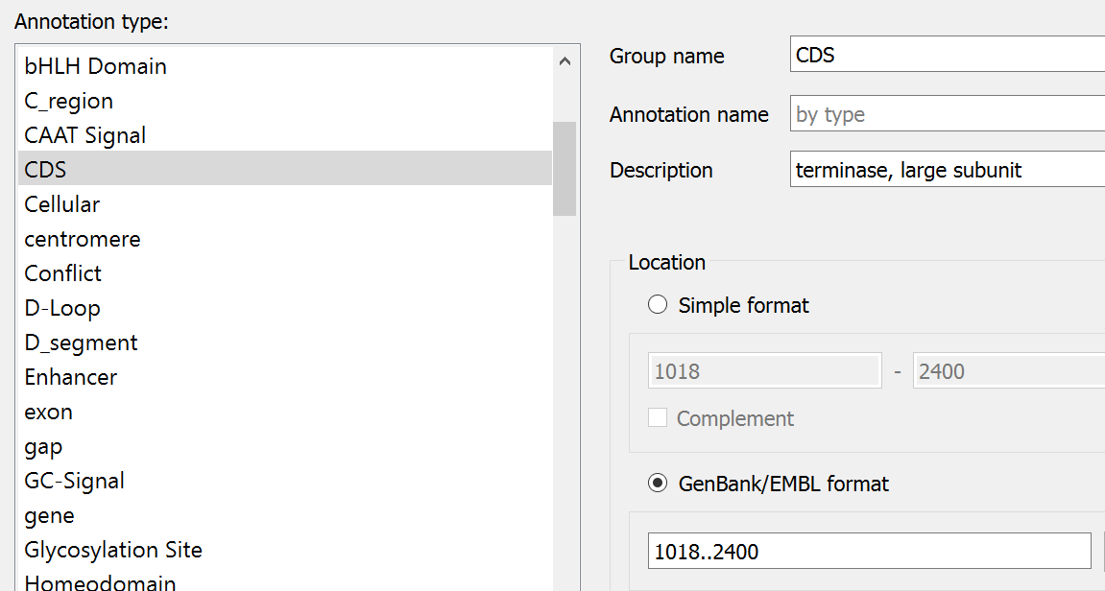
Add new annotation
Under “Actions” in the top bar choose:
“Add” and “New annotation”

Slide 33

Alternatives
NCBI’s Genome Workbench – Windows, Mac, Ubuntu; discontinued 2024 (https://ftp.ncbi.nlm.nih.gov/toolbox/gbench/ver-3.9.1/)
DNA Master
https://phagesdb.org/DNAMaster/

Slide 34

ORF versus CDS
Open Reading Frames vs Coding Sequences
DFAST identified 91 CDSs in Pseudomonas phage Jeff
NCBI’s Open Reading Frame Finder “ORF finder” ORFs found: 795 Genetic code: 11 Start codon: 'ATG' and alternative codons https://www.ncbi.nlm.nih.gov/orffinder/
Basic difference is that CDSs are preceded by ribosome-binding sites

Slide 35
CDS, ORF and Genes - optional
“Most protein sequences are derived from translations of CoDing Sequence (CDS) derived from gene predictions. A CoDing Sequence (CDS) is a region of DNA or RNA whose sequence determines the sequence of amino acids in a protein. It should not be mixed up with an Open Reading Frame (ORF), which is a series of DNA codons that does not contain any STOP codons. All CDS are ORFs, but not all ORFs are CDS...”
(https://www.uniprot.org/help/cds_protein_definition)

Slide 36
ORF vs CDS 2 - optional
an ORF is a sequence that has a length divisible by three and is bounded by stop codons
stop codons - TAA, TAG or TGA
may not specify a protein
(Sieber P, Platzer M, Schuster S. 2018. The Definition of Open Reading Frame Revisited. Trends in Genetics, 34 (3): 167-170)

Slide 37
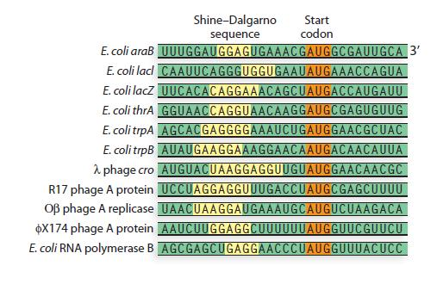
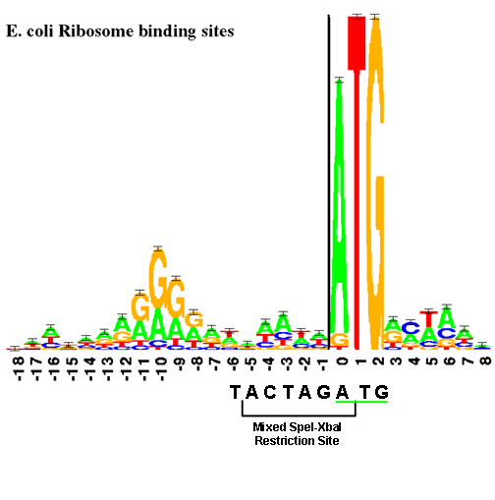
CDS - optional
N.B. No matter what the “start” codon it is always translated as M (Met, methionine)
Notes:
(http://www.chegg.com/homework-help/questions-and-answers/figure-contains-several- examples-shine-dalgarno-sequence-gold--using-seven-shine-dalgarno--q4622538)

Slide 38
File format interconversions - PART 2C
Genome2D – conversion
Baerends RJ et al. 2004. Genome Biol. 5(5): R37. doi: 10.1186/gb-2004-5-5-r37. PMID: 15128451.
http://genome2d.molgenrug.nl/g2d_tools_ conversions.html
Warning: is the conversion what you expected? Are there any spurious characters? Do all the proteins begin with M?

Slide 39
Solution
use UGENE to examine/alter start of this gene
manually change start in Notepad/Notepad++

Slide 40
BLASTp as an annotation tool
run your proteins against Caudoviricetes (taxid:2731619)
always compare size of your protein with the consensus of its NCBI “hits”
don’t concentrate on first “hit” since it may say “DNA polymerase” while all the rest say “hypothetical protein”
Geneious has a very useful BLAST tool; more user friendly than NCBI BLAST

Slide 41
What do I call my gene product (i.e. protein)?
“phage hypothetical protein” – redundant, all these proteins are “phage proteins”
“gp87” (gp = gene product)
→ hypothetical protein
gp200 describes radically different proteins in Listeria, Enterococcus, Mycobacterium, Rhodococcus, Sphingomonas, Pseudomonas,
Bacillus and Synechococcus phage genomes
Add /note=“similar to gp43 of Escherichia phage T4”
Notes:
Gp200 from Pseudomonas phage 201phi2-1 is related to phiKZ gp120 and EL gp78

Slide 42

Gene Product Nomenclature 2
/product=“UboA”; “Mcp”; “NrdA”; “hypothetical protein SA5_0153/152”; “ORF184” (as bad as gp184); “RNAP1”; "32 kDa protein”
N.B. Unless you are a bioinformatician or biostatistician be very conservative in recording “hits.” Could you convince your grand- mother?, if not, list as a “hypothetical protein” but do take a stand -“putative DNA polymerase” is cowardly
“Grandmother rule”
Bad because they don`t mean anything to the casual (or informed) reader.

Slide 43
Use Consistent Nomenclature
All of these describe homologs of the products related to the coliphage T4 rIIA protein!
rIIA protector from prophage-induced early lysis
protector from prophage-induced early lysis
protector from prophage-induced early lysis rIIA
membrane-associated affects host membrane ATPase
rIIA membrane-associated affects host membrane ATPase
phage rIIA lysis inhibitor
rIIA protector
rIIA
rIIA protein
membrane integrity protector
hypothetical protein
unnamed protein product !!!!!!
protein of unknown function

Slide 44
Nomenclature Sins
hypothetical protein → DNA polymerase with no or poor quality evidence is far worse than:
DNA polymerase → hypothetical protein
Miss-annotation creep → database poisoning
Be cautious about employing BLASTp hits in naming proteins – is there additional evidence to back the designation up?

Slide 45
Resources
UniProt Knowledgebase (UniProtKB) is a catalog of information on proteins with is manually curated and reviewed (check Proteomes). (https://www.uniprot.org/). Includes a BLAST feature.
e.g. “capsid protein” versus head protein

Slide 46
Resources 2
ViralZone (https://viralzone.expasy.org/) - a knowledge resource to understand virus diversity. Click on proteome for any viral genus.
Linked to UniProt Knowledgebase (UniProtKB)

Slide 47


Extending the annotation
using the phage_proteins.faa file
general protein motif searches:
Batch Web CD-Search Tool - https://www.ncbi. nlm.nih.gov/Structure/bwrpsb/bwrpsb.cgi Change “Expect value” to 0.00001
InterPro - https://www.ebi.ac.uk/interpro/
Open latter results (*.tsv) in Excel

Slide 48
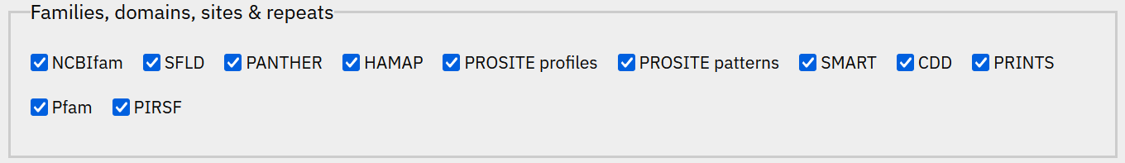
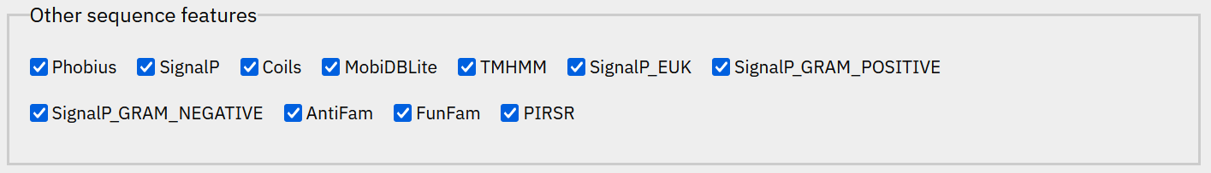
InterPro
Under “Advanced options” consider running
separately:

Slide 49

Transmembrane domains
using the protein.faa file
a good resource:
in the case of Jeff six proteins, all identified as “hypothetical proteins,” were identified to possess transmembrane domains (TMDs)
in *.gbk file change “hypothetical protein” to “hypothetical membrane protein” and add: /note=“three transmembrane domains identified using DeepTMHMM"
DeepTMHMM - https://services.healthtech.dtu. dk/services/DeepTMHMM-1.0/
Notes:
https://www.biorxiv.org/content/10.1101/2022.04.08.487609v1.full Topcons2 not yet a webserver

Slide 50
HHpred
Identification based upon similar structure
https://toolkit.tuebingen.mpg.de/tools/hhpred
Introduction - https://seaphages.org/video/87/
HHpred is useful for remote protein homology detection and structure prediction
cannot be run remotely in batch mode
worth local installation if you are seriously into phages

Slide 51
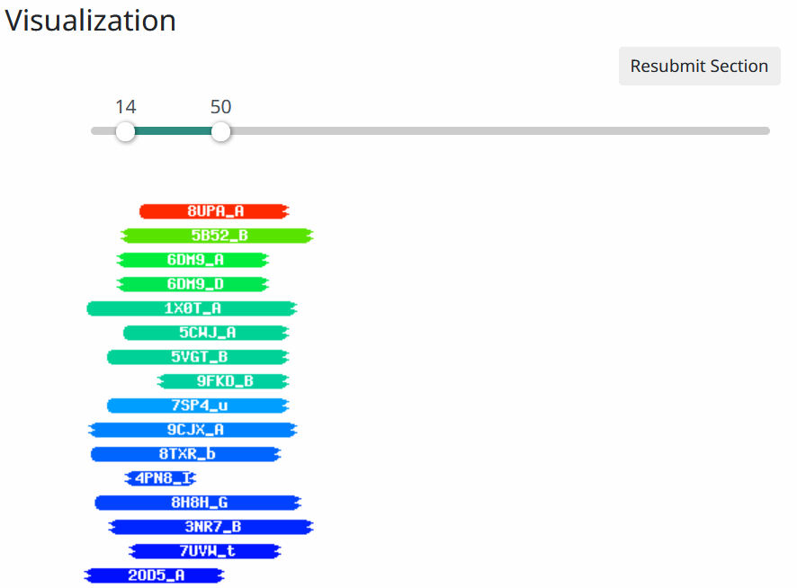
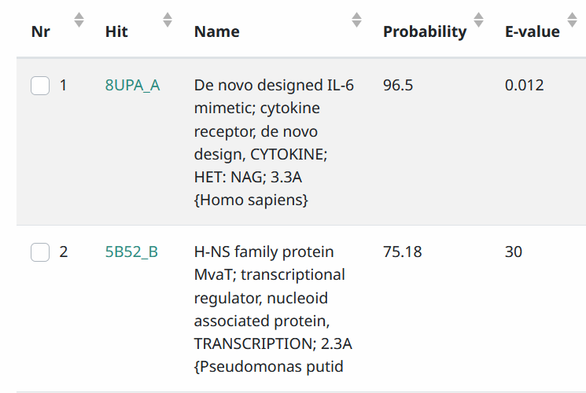

Details
Is it likely that a phage would encode a cytokine?

Slide 52
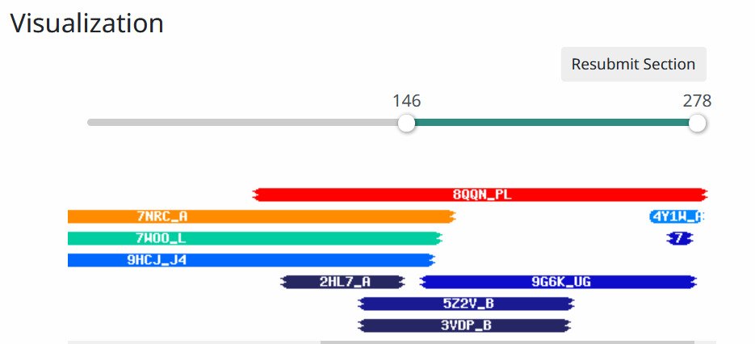
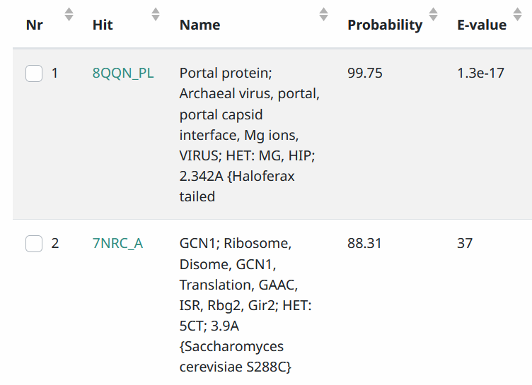
Details 2
Is it likely that a phage would encode a portal protein?

Slide 53
Phage therapy important questions
Is my phage temperate or lytic?
Does it carry virulence determinants?
Does it carry antimicrobial resistance genes?
The latter two points are dealt with by DFAST
Alternative approaches listed next

Slide 54
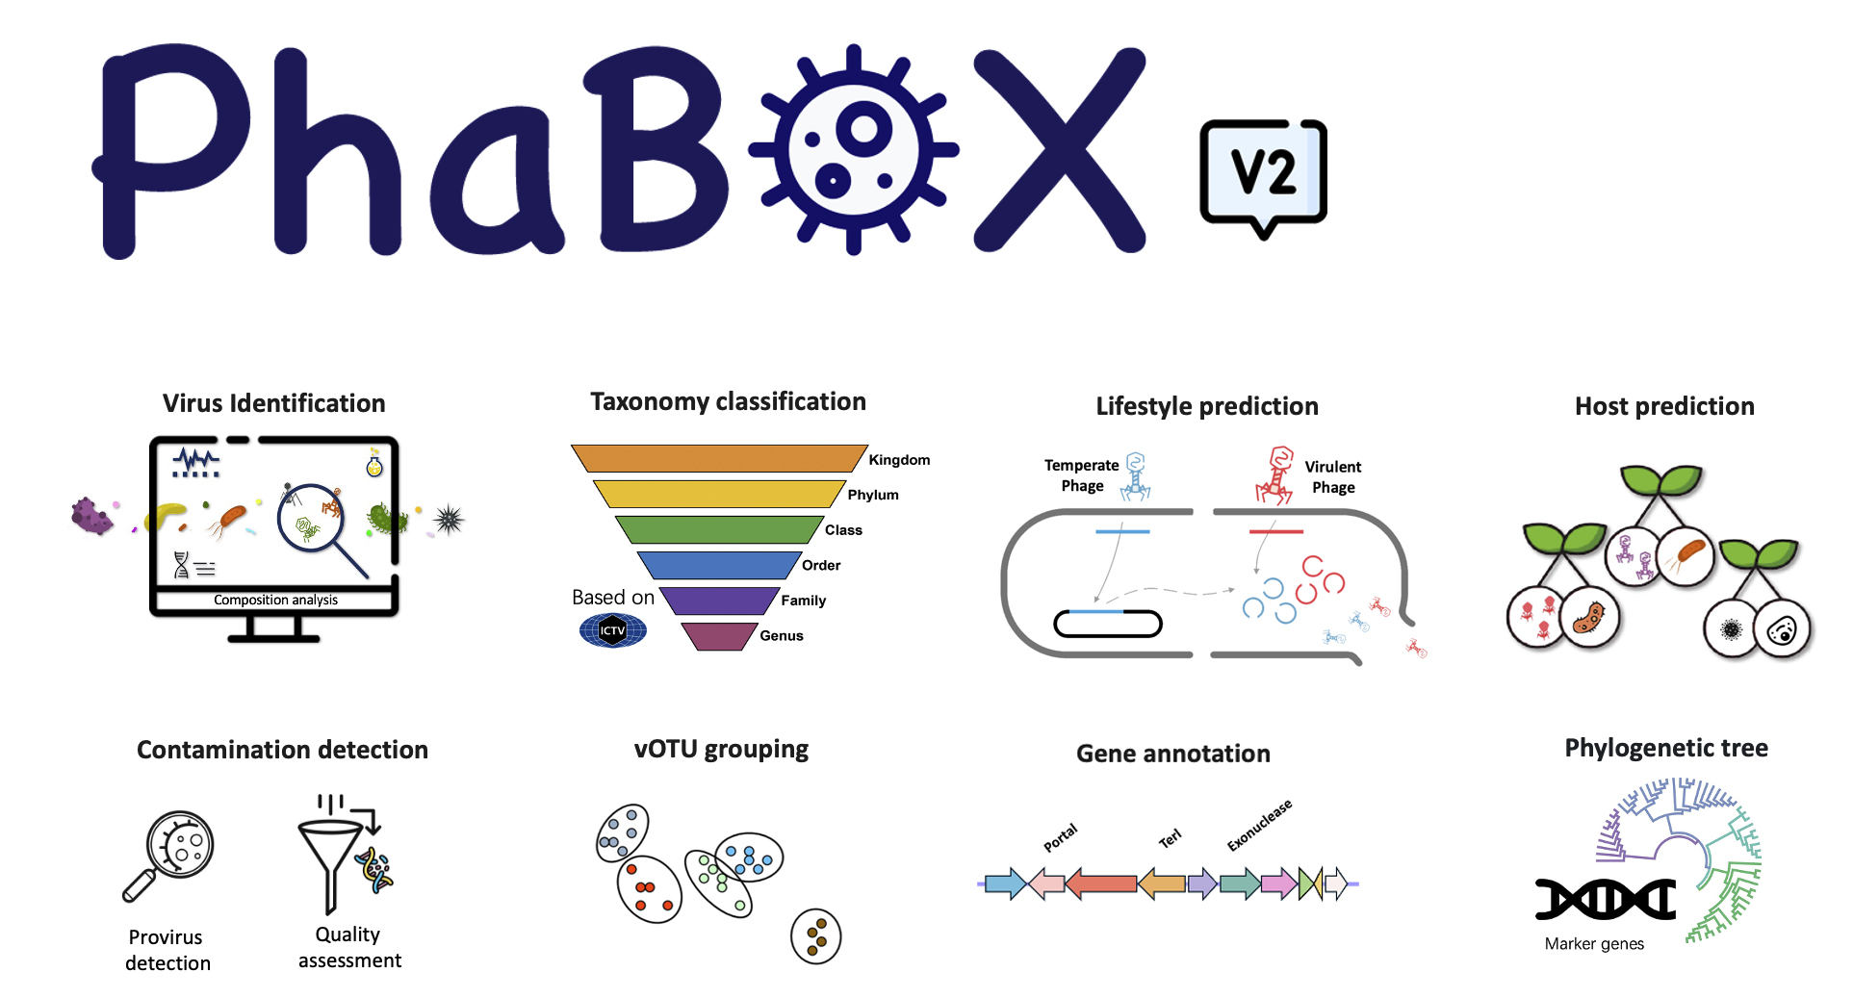
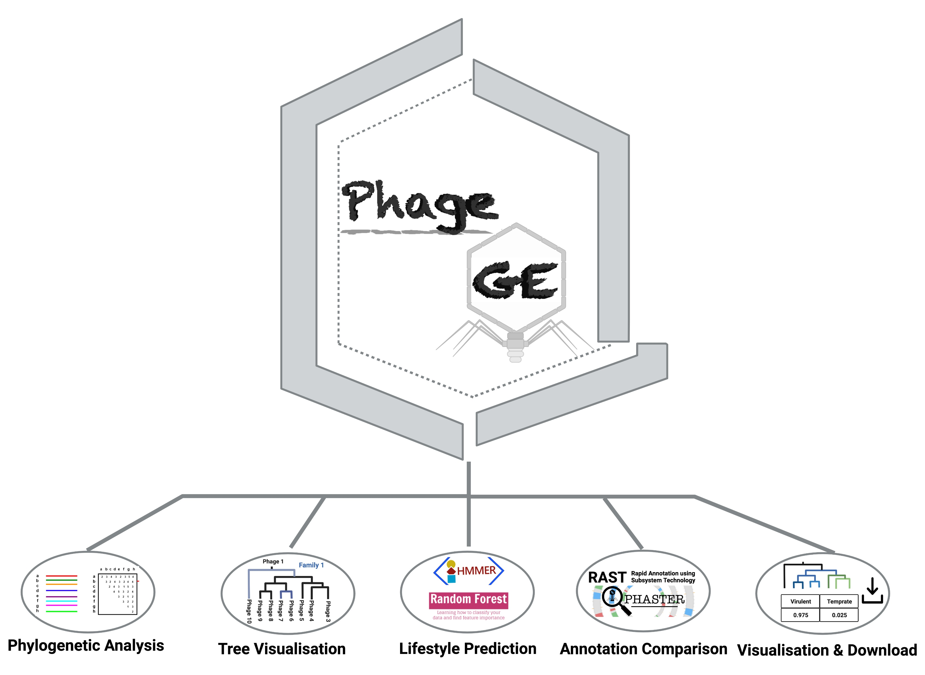
Phage therapy important questions
Is my phage temperate or lytic?
Phage Lifestyle Prediction Servers
https://www.phage.ai/
requires registration
https://phage.ee.cityu.edu.hk/phabox
PhageGE – Lifestyle prediction
https://jason-zhao.shinyapps.io/ PhageGE_Update/

Slide 55
AMR & Virulence Factors
Antimicrobial resistance – CARD (Comprehensive Antibiotic Resistance Database) - https://card.mcmaster.ca/
Use RGI Resistance Gene Identifier with DNA sequence at: https://card.mcmaster.ca/analyze/rgi

Slide 56

AMR & Virulence Factors 2
Virulence factors can be found using VFanalyzer at VFDB (Virulence factors of Pathogenic Bacteria)
https://www.mgc.ac.cn/cgi-bin/VFs/v5/main.cgi
SLOW
OR: Local BLAST versus VFDB “Protein sequences of core dataset)” using BioEdit 7.7 (Windows)
https://bioedit.software.informer.com/
OR UGENE
Notes:
unique ID : Feb_25-1469992330

Slide 57
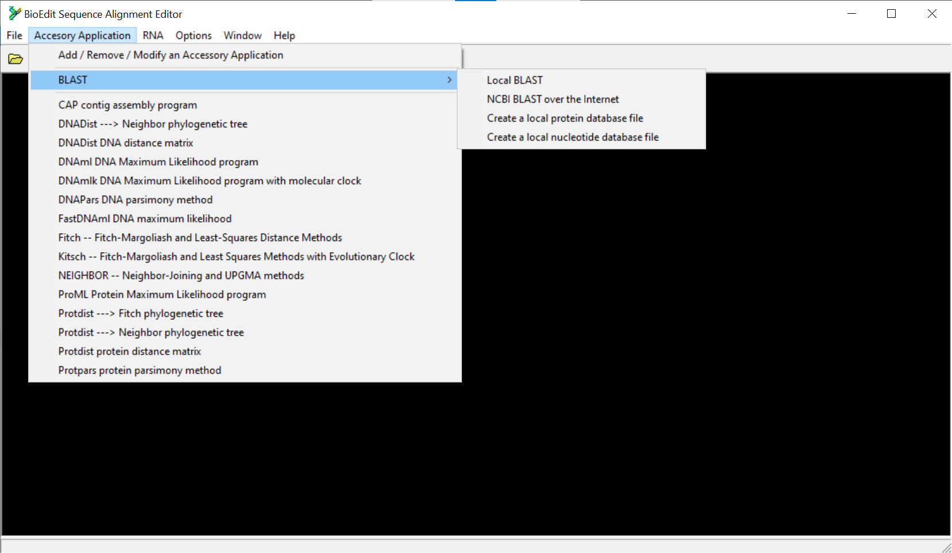
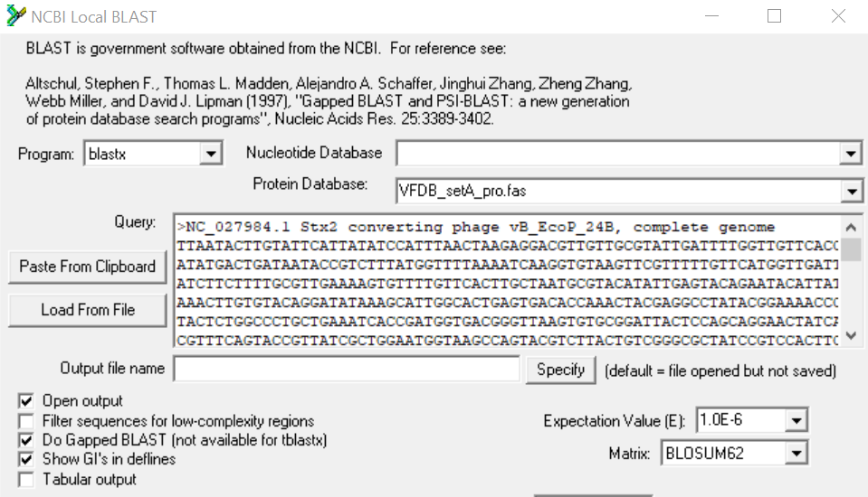
AMR & Virulence Factors 3
Select “VFDB_setA_pro.fas”

Slide 58

AMR & Virulence Factors 4
“Do Search”
Use caution in interpreting “hits”

Slide 59
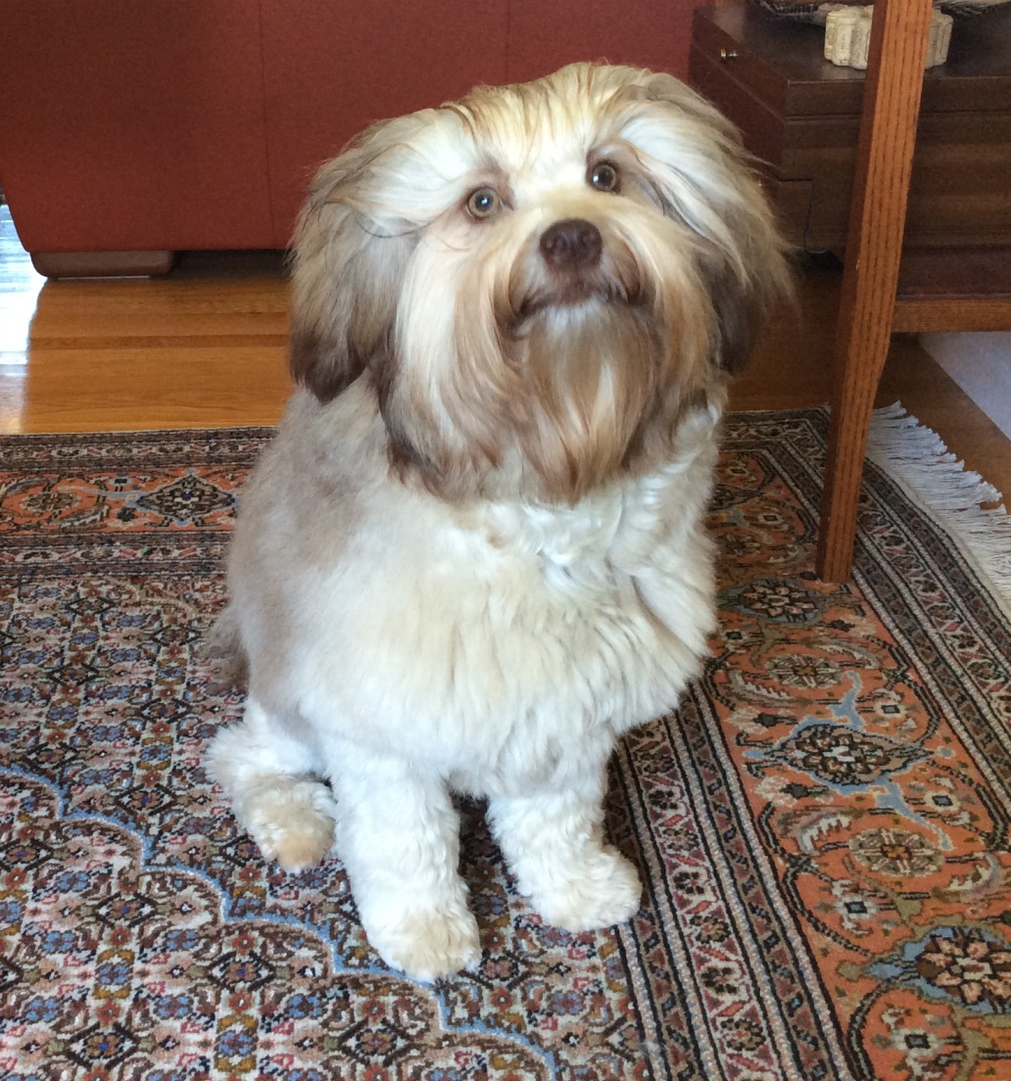
End of Part 2
Questions?

Slide 60
Notes on RAST

Slide 61

Create new project in RAST
Choose this
Select “Upload New Job”

Slide 62
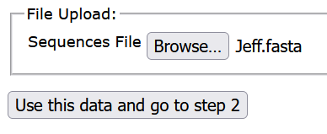

RAST Step 2

Slide 63

RAST Step 3
Use this number for Caudoviricetes
Insert Virus here

Slide 64

RAST Step 4

Slide 65


RAST – waiting for results
Check periodically since this page does not refresh

Slide 66



RAST Jobs Overview

Slide 67

Cleaning up RAST output
No locus tags
Phage is redundant

Slide 68


Clean-up using Notepad++
Under “Search” and “Replace”
Under “Search” and “Find” modify “Phage”

Slide 69

Final version

Slide 70
Notes on Pharokka

Slide 71



Pharokka – the only phage-specific pipeline
Google Colab
Notes:
https://academic.oup.com/bioinformatics/article/39/1/btac776/6858464

Slide 72

Pharokka workflow
“PHANOTATE considers unique features of phage genomes such as small gene size, high coding density and alternative start codons”
The average protein-coding density of bacterial geno- mes is 87 % (McCutcheon and Moran 2012). Phage
often >95%

Slide 73



Pharokka via Galaxy
https://usegalaxy.eu/
Also available at: https://usegalaxy.org.au/
Need to register to use these servers
Start here

Slide 74


Uploading genome sequence

Slide 75

Choose Tools

Slide 76


Choose parameters & Run

Slide 77



Running and output

Slide 78

Output
GenBank Flat File (*.gbk)
GFF3-formatted File (*.gff)
Genome Fasta File (*.fna)
Protein Fasta File (*.faa)
CDS Fasta File (*.fna)
RNA Fasta File (*.fna)
Feature Table (*.tsv)

Slide 79
Pharokka via Google Colab
Google Colab
https://colab.research.google.com/github/gbouras 13/phold/blob/main/run_pharokka_and_phold_ and_phynteny.ipynb
Need to register to use this server
Windows with Google Chrome NOT Mac M1/ Safari

Slide 80
Advantages of this version over Galaxy version
Allows one to specify the Locus tag name – use name of phage
Automatically generates zipped file

Slide 81



Loading programs and databases
Notes:
https://colab.research.google.com/github/gbouras13/phold/blob/main/run_pharokka_and_phold_and_phynteny.ipynb

Slide 82


Loading sequence
2. Upload sequence
3. Same name
1. Choose file (*.fasta)
4. Adjust

Slide 83

Running Pharokka

Slide 84




Output

Slide 85
Problems with Pharokka
locus_tags include the word CDS and are sequential from 0001 – N.B. phages don’t have thousands of genes
locus_tag numbers increase by one unit – N.B. if a CDS is missing you will have to use A, B, C after the number.
translation code may not be included in *.gbk file.
you cannot change the translation code (11). N.B. Some large, uncultivated phages of the gut microbiome - predominantly Lak phages and crAssphages - have recoded the TAG or TGA stop codon (genetic codes 15 and 4).
Notes:
https://pmc.ncbi.nlm.nih.gov/articles/PMC9197471/

Slide 86
Problems with Pharokka 2
annotation is not perfect
splicing not recognized
in GenBank record this is reported as CDS join(99941..100807,101606..103957)
important with members of the Herelleviridae, such as Staphylococcus phages; and, Campylobacter phages

Slide 87
Introns and Inteins – rare but
the gene encoding the aerobic ribonucleoside diphosphate reductase (large subunit) from Campylobacter phage vB_CcoM-IBB_35 is located on a 4.5 kb region which homologous to a 2.3 kb region from Klebsiella phage vB_KleM-RaK2. N.B. proteins have similar mass.
N.B. the thin grey line joining blocks indicates a downstream sequence which is similar
Notes:
Bottom line – look out for the unexpected particularly in the case of Staphylococcus and Campylobacter phages

Slide 88
Editing primary annotation (*.gbk) files
No matter what program you use you will have to edit the results
Notepad++ is better than Notepad

Slide 89


Open in Notepad++
Install from: https://notepad-plus-plus.org/
Review: https://www.youtube.com/watch?v=wVfbFe57h2o
Under: “Search” choose “Mark” and “Mark All”
Select

Slide 90


Mark All/Delete
Under “Search”, choose “Bookmark” and “Remove Bookmarked Lines”

Slide 91

Modify locus_tag
Under “Search” choose “Replace” and “Replace All”
Select
Changes /locus_tag=“Jeff_CDS_0001“ to /locus_tag=“Jeff_001"

Slide 92


Progress

Slide 93

Edit top of *.gbk file

Slide 94
Editing DEFINITION, SOURCE and ORGANISM
DEFINITION - Pseudomonas phage Jeff, complete genome
SOURCE - Pseudomonas phage Jeff
ORGANISM Pseudomonas phage Jeff
Viruses; Duplodnaviria; Heunggongvirae; Uroviricota; Caudoviricetes; Pbunavirus; Pseudomonas phage Jeff.
This will be discussed on the last day of this workshop
BUT in many cases the taxonomy can be readily
assessed from the BLASTN hits

Slide 95

Pharokka protein function summary
pharokka_cds_functions.tsv
Odd – Endolysin, holin, spannins
68%
Therapeutic
potential

Slide 96

Pharokka/phanotate output
>Jeff_CDS_0101 tail length tape measure protein
HQARPVGRAIHRRIVVSKLIPFNSIDGDVKFKLEVVDEAEIVLVDVSV STSQFRKFWPIADSLCWDEEKAEFVPRYKSSYLQGATEFSNRALLAF AAGQYYLRADQGRKDESEGVTSDES…. (total 320 amino acids)
WEIRD
BLASTp or PSI-BLAST versus Caudoviricetes (taxid:2731619)

